Slide 1
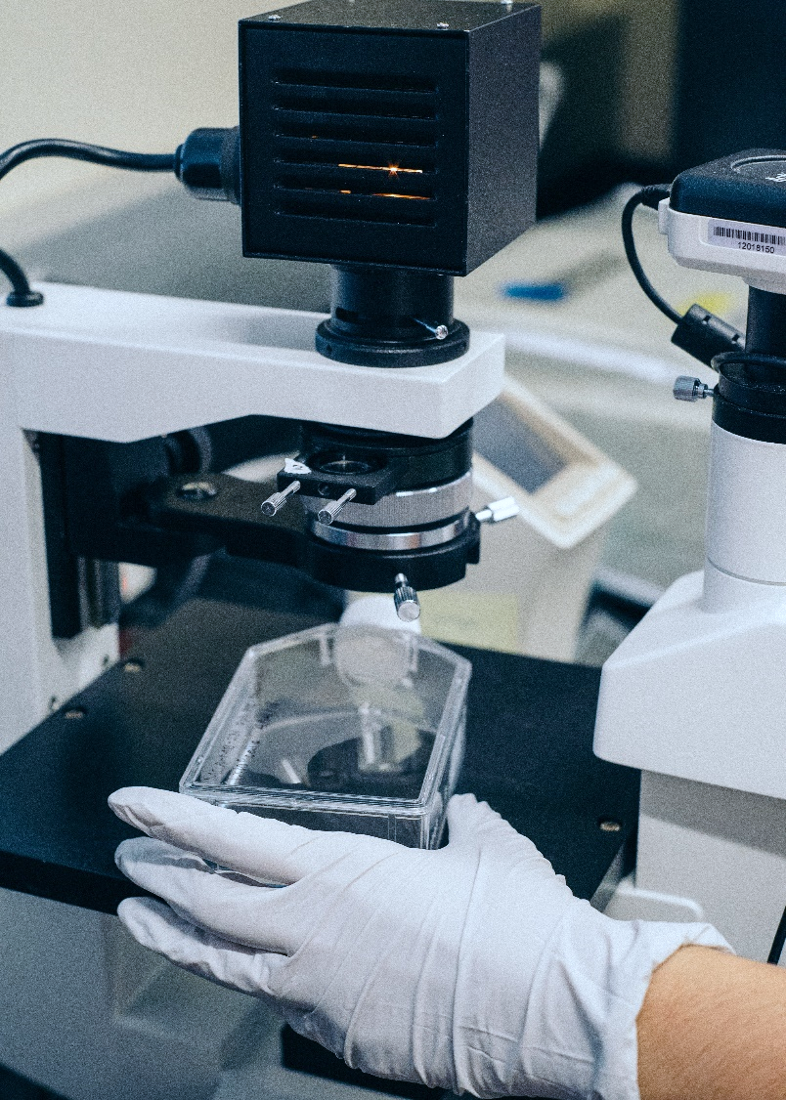
MEMÒRIA CIENTÍFICA 2020
SUMMARY 2020

Slide 2
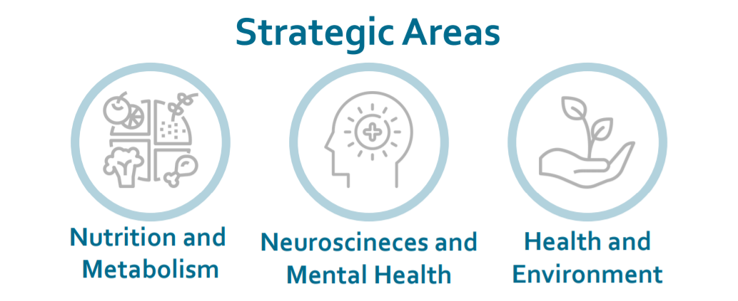
Summary 2020
18 Research groups
(17 consolidated
1 emerging)
People devoted to research
47 affiliated researchers

Slide 3
Publications 2020
Publications
Mean IF
Acumulated IF
Q1
492
4,360
2.145
341
(69%)

Slide 4
National competitive projects 2020

Slide 5
International Projects 2020
Active projects
Year | Active Projects | Funding
2017 | 7 | 220.447 €
2018 | 5 | 172.367 €
2019 | 9 | 230.089€
2020 | 9 | 339.879€

Slide 6
New clinical trials and studies 2020
TOTAL |  | 60
CLINICAL TRIALS |  | 26
OTHER STUDIES |  | 34
Phases
 | Phase II | 10
 | Phase III | 10
 | Phase IV | 0
 | Others | 6
Active clinical trials and studies 2020
TOTAL |  | 192
CLINICAL TRIALS |  | 95
OTHER STUDIES |  | 97
Phases | Phase I | 1
 | Phase I-II | 1
 | Phase II | 34
 | Phase III | 41
 | Phase IV | 7
 | Others | 11

Slide 7
Ethical Committee for Clinical Research
18%
Others
35
47%
Other invasive Studies
100
1%
Pharmacological Studies
2
Observational Studies
68
32%
Clinical research with medical products
4
3%
2%
97%
Approved
Clinical Trials with drugs
4
TOTAL
215

Slide 8


Innovation
PORTFOLIO
NEW IN 2020
PhD Theses Defended
IISPV Seminars
11
Patents
3
14
14
13
Softwares
4
Training
6
1
Training
Intellectual
Property registries

Slide 9
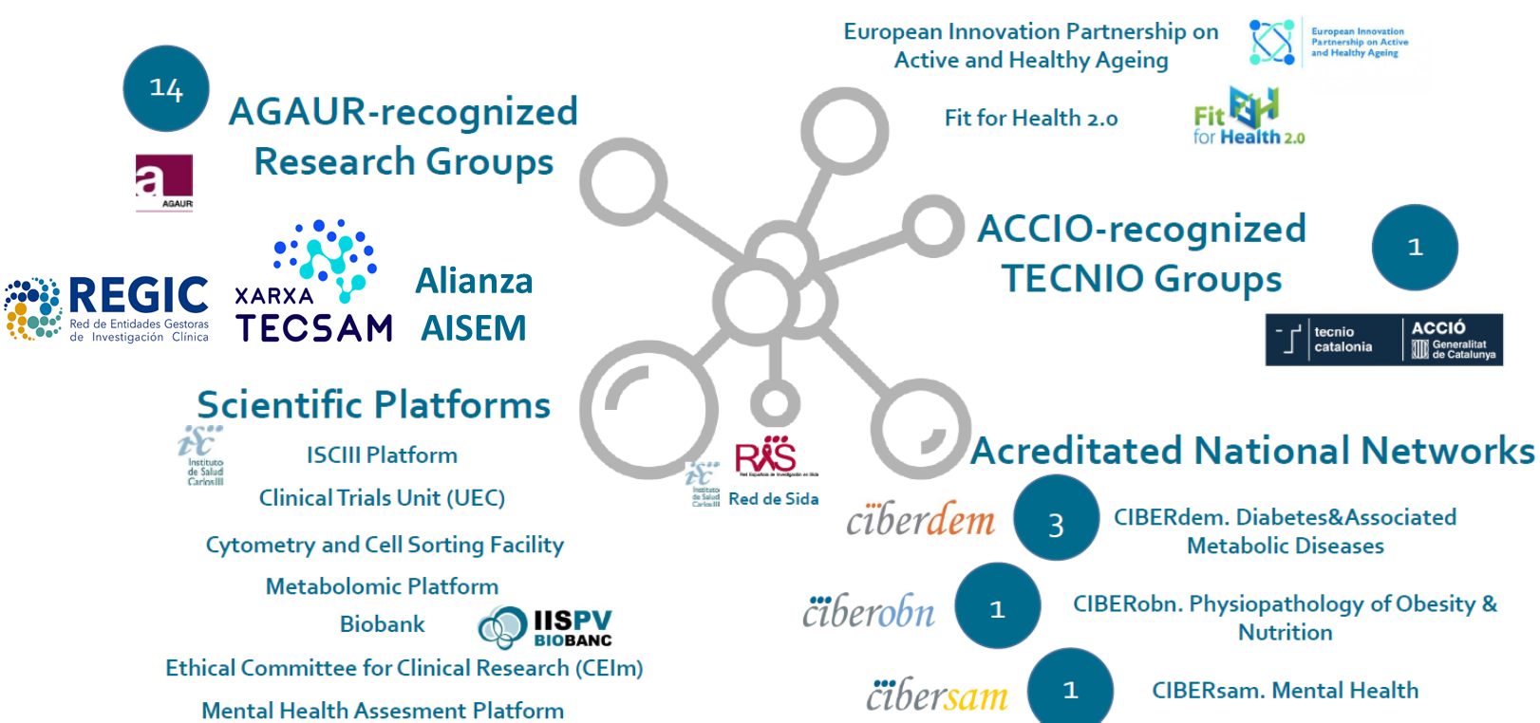
International Networks

